Slide 1


Business Analytics

Slide 2
How to adopt.

Slide 3
How to adopt
The emerging pattern of big data adoption focuses on generating a business value that can be quantizable
There are four main phases in the process of adoption and evolution of big data, along with a continuum: Educate, explore, interact and execute.
Educate: create a knowledge base. In the education phase, attention is focused on awareness and the development of knowledge.
Explore: define the business case and the road map. In this phase the focus is on developing the sheet of the company's route for the development of big data.
Interact: adopt big data. In the phase of the interaction the companies begin to check the business value of big data, as well as to carry out an assessment of their technologies and skills.
Execute: implement big data at scale. In the execution phase, the level of operability and implementation of the analytical and big data functions is greater within the company.

Slide 4
How to adopt: 4 phases.
Educate
Focused on the collection of knowledge and observations from the market
24%
Explore
Development of a strategy and a roadmap based on business needs and business challenges
47%
Interact
Direct big data initiatives to validate the value and requirements
22%
Execute
Deployment of two or more big data initiatives and continue to apply advanced analytics
6%
Total respondents: 1.061. Source: “Analytics: the use of big data in the real world. How the most innovative companies extract uncertain data value”. IBM Institute for Business Value

Slide 5
How to adopt. Empowerment of Big Data
Educate
Explore
Interact
Execute
No Excecutive
Senior executive of specific function
CIO
CEO
Group of executives

Slide 6
How to adopt. Data availability
Educate
Explore
Interact
Execute
In one week
In 24 hours
The same working day
as real-time flow

Slide 7
How to adopt. Main obstacles
Educate
Explore
Interact
Execute
Articulate an attractive business case
Understand how to use big data
Data Quality
Management and support attention
Analytical skills
Technical skills

Slide 8
How to adopt. Recommendations
Devote initial efforts to customer-focused results
It is essential that companies focus their initiatives of big data in areas that can provide the maximum value for the business. For many sectors, this will mean starting with a customer analytics that allows them to better serve them as a result of truly understanding their needs and being able to anticipate their future behaviors.
Develop a big data project for all
the company
A project covers the vision, strategy and requirements of big data within a company and is essential to harmonize the needs of business users with the roadmap of the implementation of IT. Create a common understanding of how the company intends to use big data to improve its business objectives.
Start with existing data to achieve short-term results
In order to achieve short-term results, while building the momentum and experience to support the big data program, it is essential that companies adopt a pragmatic approach. The most logical and profitable place to start looking for this new knowledge is within the company.
Develop analytical functionalities on
the basis of business priorities
Around the world organizations have to face to a growing variety of analytical tools, at the same time that they have to overcome a shortage of analytical skills. The big data eficiency depends on addressing this important gap. In short, companies will have to invest in acquiring both tools and skills.

Slide 9
How to adopt. Recommendations by phase
Educate to explore: create a base for action
Continue to expand your knowledge focusing on those use cases where big data provides a competitive advantage to companies, both inside and outside of their sector.
Work with different business units and business departments to identify the most crucial business opportunities and business challenges that can be addressed with better and more timely access to information. Many companies start with data and customer analytics to support their transformation agenda of front office.
Focus on strengthening your environment and infrastructure of information management, including development of a big data project. Often these projects are based on industry standards, reference architectures and other available technical frameworks and resources.
Explore to interact: turn plans into action
Verify that there is active support from a business leader as they develop their strategy and big data roadmap.
Develop the business case for one or two business opportunities or key business challenges that you plan to address through POCs or pilot projects.
At the same time that you plan the longer term requirements, you will see that your information management base and IT infrastructure are able to support the big data technologies and functionalities required for the POC or the pilot project.
Evaluate your current information governance processes and their availability to address the new aspects of big data
Analyze the current skill sets of internal resources and launch a gap analysis at those points where you need to develop and / or hire additional skills.

Slide 10
How to adopt. Recommendations by phase
Interact to execute: Understand the opportunities and challenges that await us.
Actively promote the successes of the pilot projects to keep the momentum at the same time it starts to interact with other parts of the business.
Concrete business case with validation and the quantification of the ROI and the expected benefits, including criteria and parameters of success of nests.
Identified the modifications and improvements that could be made be done in the business process now that you have access to better and more timely information (for example, marketing, sales, customer service and social networks).
Develop a competency plan to confirm the availability of adequate and necessary technical and quantitative skills to achieve both short and long-term objectives.
Execute: Accept the Big Data innovation.
Document the quantifiable results of the first successes to reinforce future initiatives.
Implement formal communications on big data throughout the company in order to continue increasing support and momentum.
Focus on expanding the technologies and skills needed to address new big data challenges in all business units, functions and geographic locations.
Stay alert on the governance of information (including information lifecycle management), privacy and security.
Continue to evaluate the tools and technologies of big data of rapid development. Keep the balance of the current infrastructure with newer technologies that increase scalability, optimization and resistance.

Slide 11
How to adopt. Different models

Slide 12
How to adopt. Different models

Slide 13
Application in different sectors.

Slide 14
Application in different sectors.
Some examples of common applications of Business Analytics.
Customer Analytics
Human Capital Productivity Analytics
Business Productivity Analytics
Sales Channel Analytics
Sypply Chain Analytics
Behavior Analysis

Slide 15
Customer Analytics
Customer profiling
The bulk of marketing traditionally casts a wide net and hopes to capture as many individuals as possible. Companies are realizing that all customers are not clones of some predefined market segment but are thinking individuals. To this end, customer analytics encompass the continuous refinement of individual customer profiles that incorporate demographic, psychographic, and behavioral data about each individual.
Targeted marketing
Knowledge of a set of customer likes and dislikes can augment a marketing campaign to target small clusters of customers that share profiles. In fact, laser-style marketing is focused directly at individuals as a by-product of customer analytics.
Personalization
As more business moves online, the browser acts as a proxy for the company's first interface with the customer. Personalization, which is the process of crafting a presentation to the customer based on that customer's profile, is the modern-day counterpart to the old-fashioned salesperson who remembers everything about his or her individual "accounts." Web site personalization exploits customer profiles to dynamically collect content designed for an individual, and it is meant to enhance that customer's experience.
Collaborative filtering
We have all seen e-commerce Web sites that suggest alternate or additional purchases based on other people's preferences. In other words, the information on a Web page may suggest that "people who have purchased product X also have purchased product Y." These kinds of suggestions are the result of a process called collaborative
filtering, which evaluates the similarity between the preferences of groups of customers.

Slide 16
Customer Analytics
Customer satisfaction
Another benefit of the customer profile is the ability to provide customer information to the customer satisfaction representatives. This can improve these representatives' ability to deal with the customer and expedite problem resolution.
Customer lifetime value
How does a company determine who their best customers are? The lifetime value of a customer is a measure of a customer's profitability over the lifetime of the relationship, which incorporates the costs associated with managing that relationship and the revenues expected from that customer. Customer analytics incorporates metrics for measuring customer lifetime value.
Customer Loyalty.
It is said that a company's best new customers are its current customers. This means that a company's best opportunities for new sales are with those customers that are already happy with that company's products or services. Customer analytics help.

Slide 17
Human Capital Productivity Analytics
Call Center Utilization and Optimization.
If you have ever dawdled while on hold, waiting for a customer service representative to pick up the telephone, you can understand the value of analyzing call center utilization to look for ways to improve throughput and decrease customer waiting time. When a company's management realizes that inbound calls are likely to be from unsatisfied customers, making them stew on the phone is not going to improve customer satisfaction. In the more advanced cases, quick access to customer profile information may also affect the level of support provided to each customer (e.g.,
high level to high-value customers, minimal support to low-value customers).
Production effectiveness.
This includes evaluating on-time perfor- mance, labor costs, production yield, etc., all as factors of how staff members work. This information can also be integrated into an infor- mation repository and analyzed for value.

Slide 18
Business Productivity Analytics
Defect Analysis.
While companies struggle to improve quality produc- tion, there may be specific factors that affect the number of defective items produced, such as time of day, the source of raw materials used, and even the individuals who staff a production line. These factors can be exposed through one component of business productivity analytics.
Capacity Planning and optimization.
Understanding resource utilization for all aspects of a physical plant (i.e., all aspects of the machinery, personnel, expected throughput, raw input requirements, warehousing, just-in-time production, etc.) through a BI anal)tics process can assist management in resource planning and staffing.
Financial Reporting.
Stricter industry regulatory constraints may force companies to provide documentation about their financials, especially in a time when companies are failing due to misstated or inaccurately stated results. In addition, financial reporting analytics provide the means for high-level executives to take the pulse of the company and drill down on particular areas.
.
Risk Management.
Having greater accuracy or precision in tracking business processes and productivity allows a manager to make better decisions about how and when to allocate resources in a way that mini- mizes risk to the organization. In addition, risk analysis can be factored into business decisions regarding the kind of arrangements that are negotiated with partners and suppliers.

Slide 19
Business Productivity Analytics
Just-in-time.
The concept of just-in-time product development revolves around the mitigation of inventory risk associated with com- modity products with high price volatility. For example, the commodity desktop computer business is driven by successive generations of com- modity components (disk drives, CPUs, DRAM memory chips, to name a few). Should a vendor purchase these items in large quantity and then come up against a low-sales quarter, that vendor might be stuck with components sitting on the shelf whose commodity value is rapidly declining. To alleviate this, the knowledge of how quickly the production team can assemble a product, along with sales channel information and supplier information (see Sales Channel Analytics and Supply Chain Analytics on page 21) can help in accurately delivering products built to customer order within a predictable amount of time.
Asset Management and Resource Planning.
Utilization, productivity, and asset lifecycle information can be integrated through business analytics to provide insight into short- and long-term resource plan- ning, as well as exposing optimal ways to manage corporate assets to support the resource plan.

Slide 20
Sales Channel Analytics
Marketing.
Both the ability to fine-tune a marketing program and the ability to determine marketing effectiveness can be derived through sales channel analytics. A typical iterative process would be to identify a marketing strategy based on an analysis of a clustering of customers by profile and then to implement that strategy. The effectiveness of the strategy will ripple through the sales channel data, which can then be used to compare the actual results with expectations. The degree to which those expectations are met (or exceeded) can be fed back into
the analytical processing to help determine new strategies.
Sales Performance and Pipeline.
Data associated with the sales staff can be analyzed to identify variables that affect the efficiency of the sales cycle, such as individual sales staff member, region, industry, contact people, contact times, and contact frequency.

Slide 21
Sypply Chain Analytics
Supplier and Vendor Management.
Many organizations are unable to identify who their vendors are or how many vendors are supplying products or services. Supply chain analytics allow a company's manage- ment to track performance and reliability by supplier, evaluating and rating the quality of the products supplied, as well as help to optimize supplier relationships with respect to spending, procurement, and risk.
Shipping.
There are different methods by which a company delivers its products to its customers, each with its own cost schedule. For example, it may be more expensive to ship products by air than by truck, but the products will arrive at the destination faster if shipped by air. A company can minimize its delivery costs by being able to select he most efficient delivery method for any specific business arrange- ment, but knowing whether the products can be available within the right time schedule is a difficult problem, especially if your production depends on external suppliers. Therefore, merging supplier and inven- tory information with productivity data (see Business Productivity Analytics on page 19) lets management accurately determine the best way to move product.

Slide 22
Sypply Chain Analytics
Inventory Control.
As discussed earlier, maintaining an inventory of commodity products that exhibit volatile pricing and limited useful life creates a market risk if those products cannot be used before their obso- lescence. Alternatively, we would not want to keep the shelves empty, because parts are needed to build the products that are in the order- and-fulfillment cycle. Between the sales channel information, the pro- ductivity data, and the supply chain data, it is possible to make more precise predictions about inventory requirements. It is also possible to determine the best way to quantify and mitigate risk, especially through the development of financial products (such as barrier options) to limit financial losses.
Distribution Analysis.
Imagine that your company has a large number of retail outlets, a smaller number of regional warehouses, and a very small number of factories. The optimal distribution model would arrange for the delivery of the exact number of products from each factory to its closest warehouses so that each warehouse could deliver the exact number of products to each of the retail stores. Unfor- tunately for both companies and customers, this optimal distribution is pretty rare. If a company can predict demand for specific products within certain areas, though, the managers cannot only distribute the product to the right locations in the right quantities, but also minimize shipping costs by ramping up product creation at the factories most economically geographically located at a rate that matches the con- sumer demand.

Slide 23
Behavior Analytics
Purchasing Trends.
Although many product lifecycles can easily be predicted and charted, there are apparent nonlinear trends that elude predictability, the most notable cases being toy sales around winter holiday time. Yet not being able to identify a warming (or heating!) product may result in the inability to ramp up production to meet demand or the inability to move products from factory to store shelves, which can effectively dump a glass of cold water on that hot product. Behavior analytics can be used to identify purchasing patterns that indicate a growing trend that can be used to adjust a company's reaction to customer trends.
Web Activity.
In the world of e-commerce, the ability to draw and maintain customers to a Web site and then encourage them to commit to purchasing products is not only critical to success, but also much more difficult than doing the same in a brick and mortar environment. Different kinds of content presentation may lead different kinds of consumers to behave differently. It is interesting to identify patterns that lead to committed business (e.g., product purchase)mlet's call them "success patterns." Then perhaps including some personalization (see Customer Analytics on page 18), the content presentation can be crafted to direct the Web site visitor into these success patterns, which in theory should improve the probability of making a sale.

Slide 24
Behavior Analytics
Fraud and Abuse Detection.
Fraudulent (or abusive) behavior fre- quently is manifested in patterns. For example, there are many popular health insurance fraud schemes involving making claims with inflated charges or practitioners prescribing expensive medications or procedures that may not be necessary. Behavior analytics can be used to seek out patterns of suspicious behavior by provider, geographical region, agent, etc.
Customer Attrition.
Another serious problem for many businesses is customer attrition, when a company's customers decide they no longer want to remain affiliated with that company. In competitive industries, it is much easier to convince a customer to stay with the company before the decision has been made to leave rather than afterwards. For example, offering a long-distance telephone customer a better offer than can be gotten from a competitor can recapture that customer, but it is not to the company's benefit to make this offer to (higher valued) com- placent customers. Therefore, it is important to recognize the signs that a customer is ready to cease being a customer. This can be done by evaluating patterns of behavior before previous attritions (such as a history of customer service complaints) and then using those patterns for ongoing customer behavior analysis.
Social Network Analysis.
Sometimes it is important to identify rela- tionships between specific entities within a system and to analyze their behavior as a group. For example, a component of criminal intelligence is finding collections of individuals whose individual behavior may be nondescript yet who act suspiciously as a group. This kind of analytical processing is valuable to law enforcement, regulatory compliance (think of insider trading), marketing (consider viral marketing, which is a strategy that encourages individuals to pass your marketing message to all of their contacts), as well as sales optimization (by finding a contact path of people to find the right audience).

Slide 25
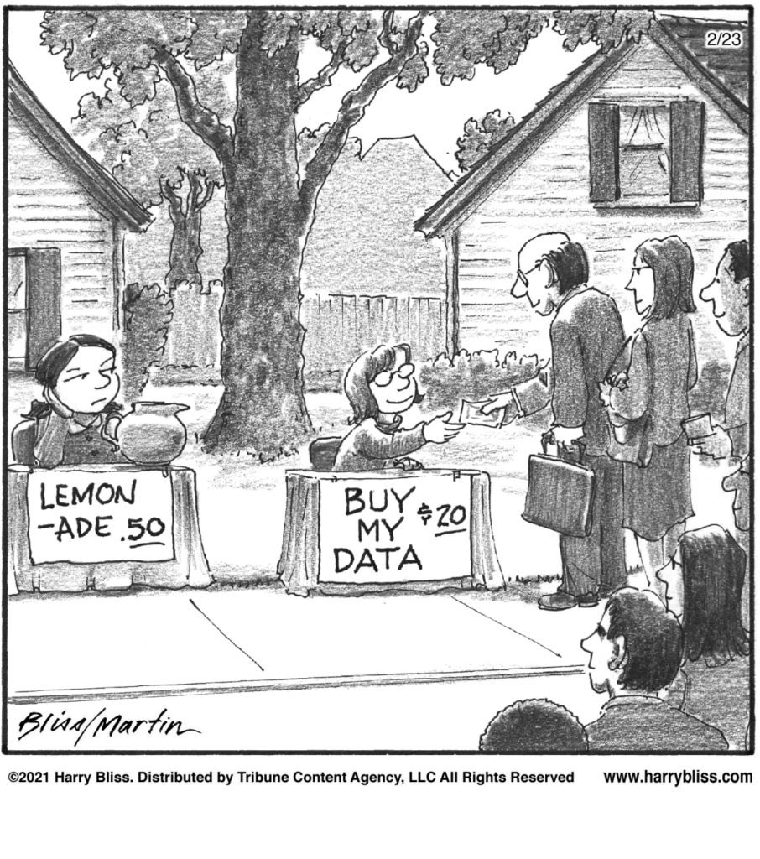

Slide 26
Thank You

